Slide 1
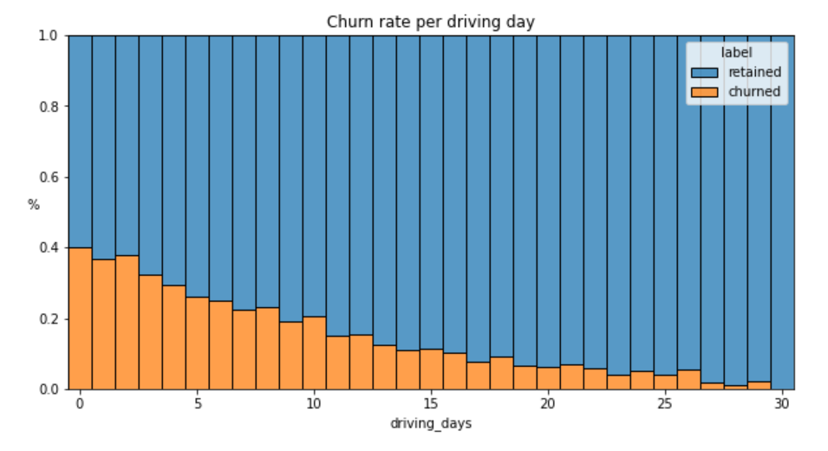
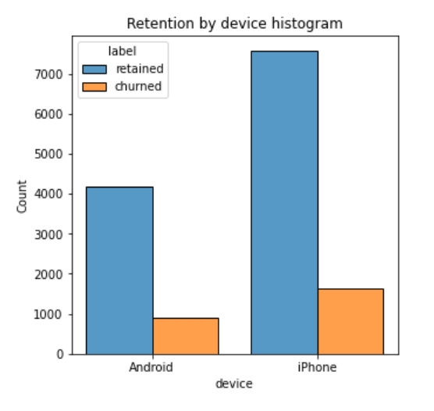
Waze User Churn Project Exploratory Data Analysis
Executive summary for Waze Leadership Team
Project Overview
Waze leadership ask data team to develop a churn predictive model that will help prevent churn. improve user retention, and grow Waze’s business. This report is by Waze data team after performing an exploratory data analysis (EDA).
The less users used the app, the more likely they were to churn. About 40% of users who did not use the app last month churned, while no user use the app churned.
Distance driven per driving day had a positive correlation with user churn. The farther user drove every day, the more likely they were to churn.
Number of driving days had a negative correlation with user churn. The more days user use the app, the less likely they were to churn.
From new users to around 10 years users are relatively evenly distributed in the data
Nearly all the variables were heavily right-skewed or uniformly distributed. For heavily right-skewed distributions, most users had values in the lower end of the range. While for uniformly distributions, most users had values anywhere within the range.
Several variables had almost impossible data, those variables are: driven_km_drives, activity_days and driving_days.
The churn rate is highest for users who didn’t use the app last month.
While the proportion of churned users and retained users are consistent compared to device type.
Investigate further problematic variables between sessions, driving days and activity days.
Investigate further long distance drivers’ churn rate to find the cause.
Run statistical analysis more to determine the impact of the churn rate

